Slide 1
Increment 1
Team 3

Slide 2
Increment Planning
Functional and Nonfunctional Requirements

Slide 3


Scenarios

Slide 4
UML Diagrams and our MVC approach
Model
Controller
View

Slide 5
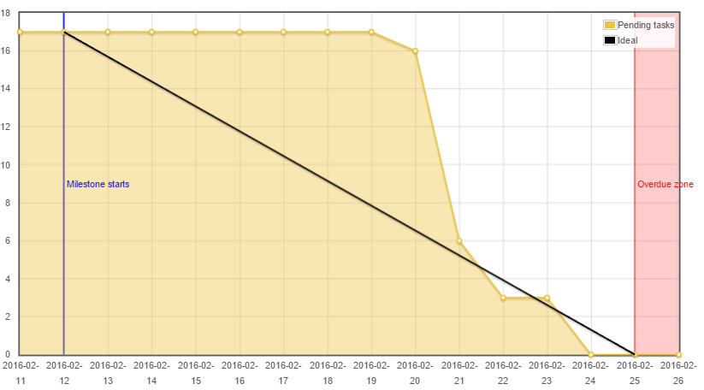
Burndown Chart

Slide 6


Testing
Next Increment
JUnit

Slide 7
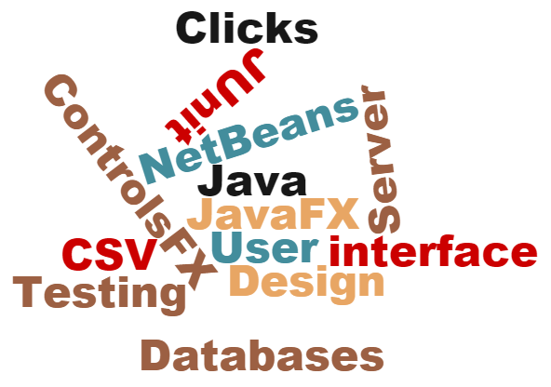
Design Choices

Slide 8
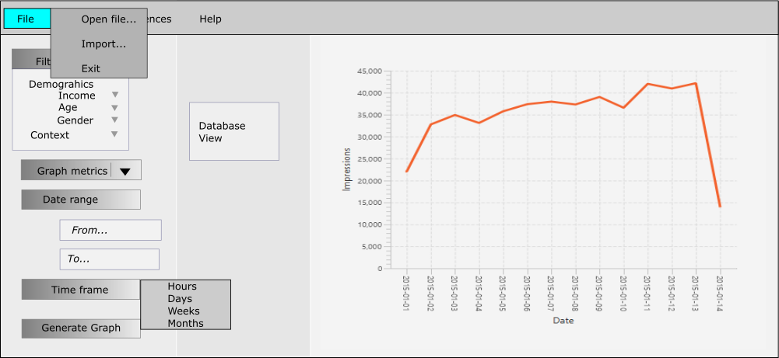
Creating the GUI

Slide 9
Thanks for Listening
Now the Demonstration

